Slide 1

Vehicle Monitoring System Based on Mobile Devices
Student:
BSE173
Roytman Sergey
Supervisor:
Department of Software Engineering Hadi Saleh
Higher School of Economics, Moscow, 2021
www.hse.ru

Slide 2

Subject field description
Vehicle Monitoring Systems
Applications
State sector:
Public transport
Garbage trucks
…
Private sector:
Delivery
Taxi
…
Notes:
Vehicle monitoring systems are widely used in state and private sectors.
That kind of systems is suitable for fleet management, in particular management of delivery trucks, taxi services, public transport, garbage trucks or business trips controlling
Commonly such systems are used for monitoring vehicle location and operational statistics, observe driver’s productivity, detecting motor vehicle collisions and thefts.

Slide 3
Basic definitions
Term | Definition
OBD tracker | Hardware device, which connects to the vehicle on-board software in order to obtain all desired information about the vehicle state
фото
фото
фото
Notes:
One of the basic definition used in this presentation is GPS tracker… GPS tracker is a

Slide 4
Relevance of the topic
фото
«GrandViewSearch»: world average growth rate will be 14% yearly from 2020 to 2027
Non-commercial partnership «GLONASS»: Russian market is soaring by 24% per year
фото
фото
Notes:
The global market of vehicle monitoring systems in 2020 was about 21.1 billion dollars and a research made by analytical agency “Grand View Search” predicts market growth by an average of 14% per year from 2020 to 2027
The Russian market is also actively developing: and is soaring by 24% per year In Russia, one of the growth drivers are the GLONASS and PLATON systems, which are actively promoted by the state. In 2020, 30% of cars are connected to at least one of these systems
Also one of the potential drivers of market growth is the emergence and spread of unmanned vehicles

Slide 5
Existing solutions
фото
фото
фото
Notes:
Modern vehicle monitoring systems global market and especially Russian one is divided by accordingly small number of companies. In Russia the market dominants are the following companies: Wialon, Omnicomm, Autograph. In general companies provide similar range of functionality with a few differences.
The main difference is GPS tracker devices supportability. GPS trackers in such systems connect directly to the on-board vehicle computer, receive vehicle operational statistics and vehicle location and then send this data to backend server using built-in SIM card mobile network.
Omnicomm and Autograph have a similar approach: they use the self-developed GPS tracker devices. Customization devices, for example for the fuel level monitoring, are selling separately. Meanwhile, Wialon – the market leader, which consumes about 40 percent of Russia’s market share, have a good advantage - its main benefit is the ability to consume data from a variety of GPS trackers.
The rest of functionality of vehicle monitoring systems is usually provided in a form of a web-application.
Core functionality consists of:
Collecting data about the state of the car and transferring them to the server
Visualization of the location of vehicles and data on their movements on the map.
Vehicle and driver management
Task management for drivers
Customizable reports: task execution, over-speeding and so on
Fleet statistics dashboard: graphs and numbers showing fleet activity over a specified time range
The main con of existing solutions is that mentioned GPS tracker devices are to be bought separately: their average price was 6500 rubles (87 $) in 2018 + installation + mobile network subscription fee + mainteneance

Slide 6
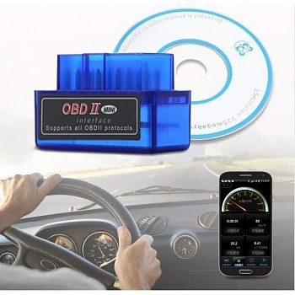
Alternative solution: goals and tasks
Goal
Implement a vehicle monitoring service that can work in two configurations:
With no OBD tracker, only with Android app:
Vehicle geolocation + datetime + driver
With simple Bluetooth OBD tracker which transmits data to the Android app
Vehicle geolocation + datetime + driver + OBD data (speed, fuel level, engine errors…)
фото
фото
Higher school of Economics, Moscow, 2021
Notes:
The key element of information about the state of vehicles in such systems is data about its current location and movements.
There are a number of clients for whom this data would be enough and they would not want to overpay for equipping each car with expensive trackers - for such clients, this project proposes to use Android devices that are widespread among drivers as a data transmitter.
But there are also clients who need additional data, such as fuel consumption, vehicle speed and others. To solve this problem, this project proposes to use cheap Bluetooth OBD trackers that do not have a built-in SIM card (and therefore additional communication costs), but which are able to send the same data set as conventional trackers via Bluetooth and cost 16 times less - around 400 rubles. An example of such a tracker is shown on the slide on the right - a small blue box that plugs directly into the OBD-2 port of a car without any wires
At the same time, the mobile application, in addition to collecting and transferring vehicle data, will also provide functionality for the driver to work with the system.
The active development of mobile devices makes this approach even more advantageous: cheaper devices, their widespread use (for example, for payment), the presence of built-in sensors (camera, video camera, gyroscope and other sensors) can expand the functionality of the mobile application and the amount of data collected from the car ...
The developed hardware and software solution will be well suited for medium and small businesses that manage a small fleet of vehicles, allowing them to save on the purchase, installation and maintenance of OBD trackers. In terms of functionality, the system intends to repeat the main functionality of popular monitoring systems.

Slide 7
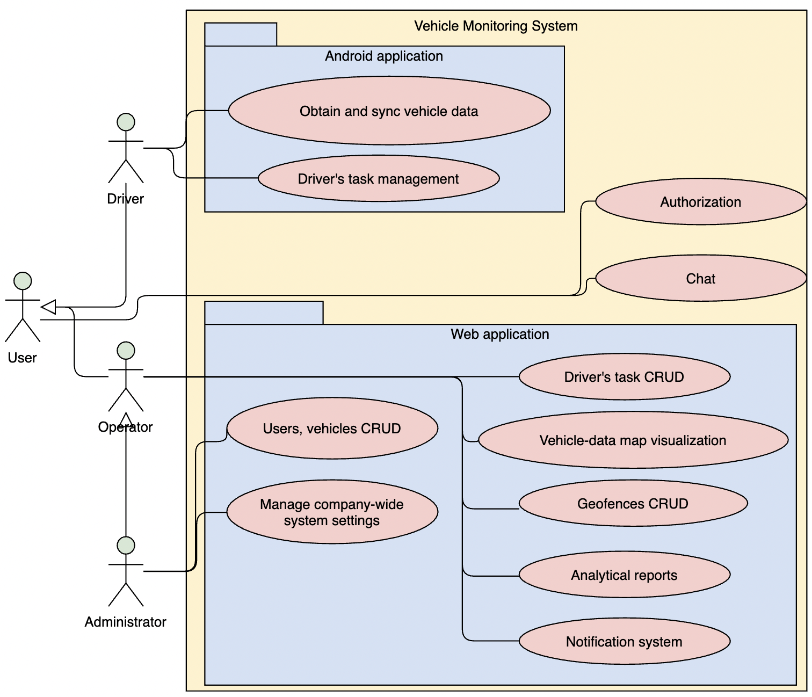
Alternative solution: functionality
фото
Notes:
Service target customers are companies, which business relay on vehicle fleet. Commonly these companies have following roles structure: drivers, operators and administrators.
Drivers are employees who are in charge of vehicles driving. Driver utilize Android application for sending vehicle’s location and other vehicle related data to the Geodata Processing Service, he can manage tasks assigned to him and communicate with the operator by chat.
Operator responsibility is to manage system related data (vehicles, drivers, tasks), analyze fleet state with the help of visualizations and analytical reports.
Administrator is the role for company-wide system customization: managing operators, managing rules for the notification system, global settings as frequency of vehicle data retrieval and its synchronization.
[Tell about functionality on slide]

Slide 8







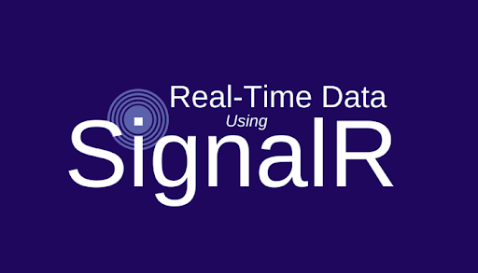
Development technologies and tools
Web backend
Web frontend
Android application
фото
фото
фото
Real-time functionality
Version control system
Authentication service
Hosting
DB
фото

Slide 9
Demonstration
Video demonstration links
English
Web application – https://youtu.be/ZCvslu-jak0
Android application – https://youtu.be/2JxMwKI8YyI
Russian
Web application – https://youtu.be/4txVzwEXWP0
Android application – https://youtu.be/vYEBtTtEsDI

Slide 10

Thank you for
your attention!
Sergey Roytman
siroytman@edu.hse.ru
Moscow - 2021

